Slide 1

SECURITY AND SAFETY
IN THE CLoud
Part 102
Mark Rendell July, 2017

Slide 2
Wait 1
sec
Inclusion
& Diversity

Slide 3
A GREAT TEAM MEMBER… | How I am accomplishing this? | How I might improve?
Promotes healthy debate among team members
Assigns tasks equitably; examines task assignment patterns for unconscious bias
Offers flexible work arrangements when possible; creates environment where these arrangements are valued
Considers other unique needs of all employees, including global employees, and plans accordingly
Works with team to understand and discuss diversity dynamics
Understands when diversity dynamics should be discussed as a whole group or with individual team members
Develops positive relationships with all employees; does not create “in” and “out” groups

Slide 4
RECAP!
Expect
That
Someone
is trying
To hack you

Slide 5

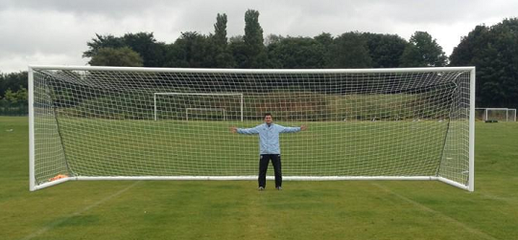
RECAP!
The imbalance
Of
Attacking
versus
defense

Slide 6
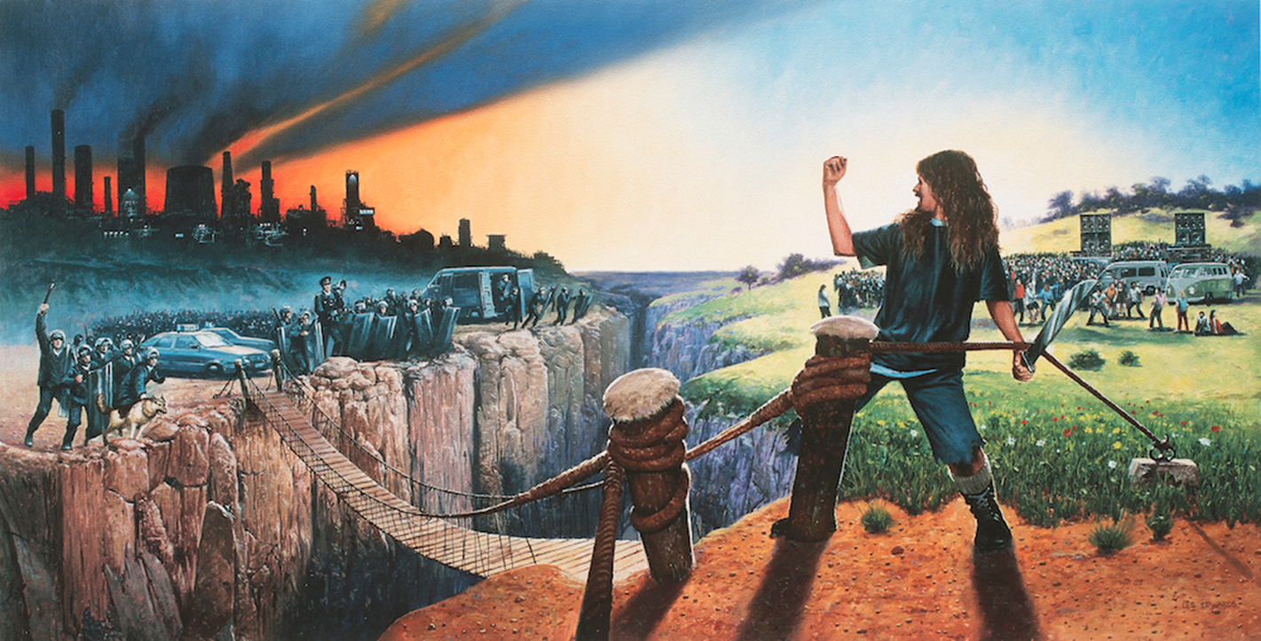
Reduce the likelihood and impact of Being hacked
RECAP!

Slide 7

RECAP!
If in
doubt
Ask
For
help
Your lead
Country lead
Markos
Project team
ASOC

Slide 8
SECURITY IN THE CLOUD 102
In this session we will cover…
Who Are We Worried About?
1
What We Are Protecting?
2
3
How Can We Use Défense In Depth?

Slide 9
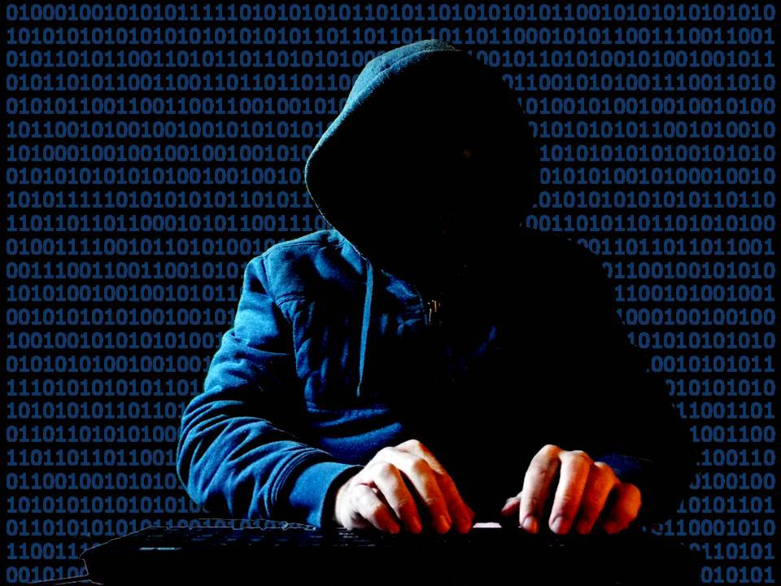
STEPPING STONES FOR SUCCESS
WHAT ARE WE PROTECTING?
What do hackers want?
Stepping Stones to Success

Slide 10


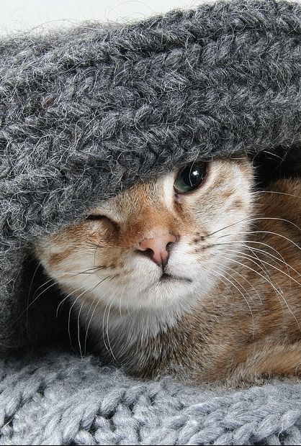
It depends on the colour of their hat
black hat, White hat, grey hat
Have difference motivations

Slide 11

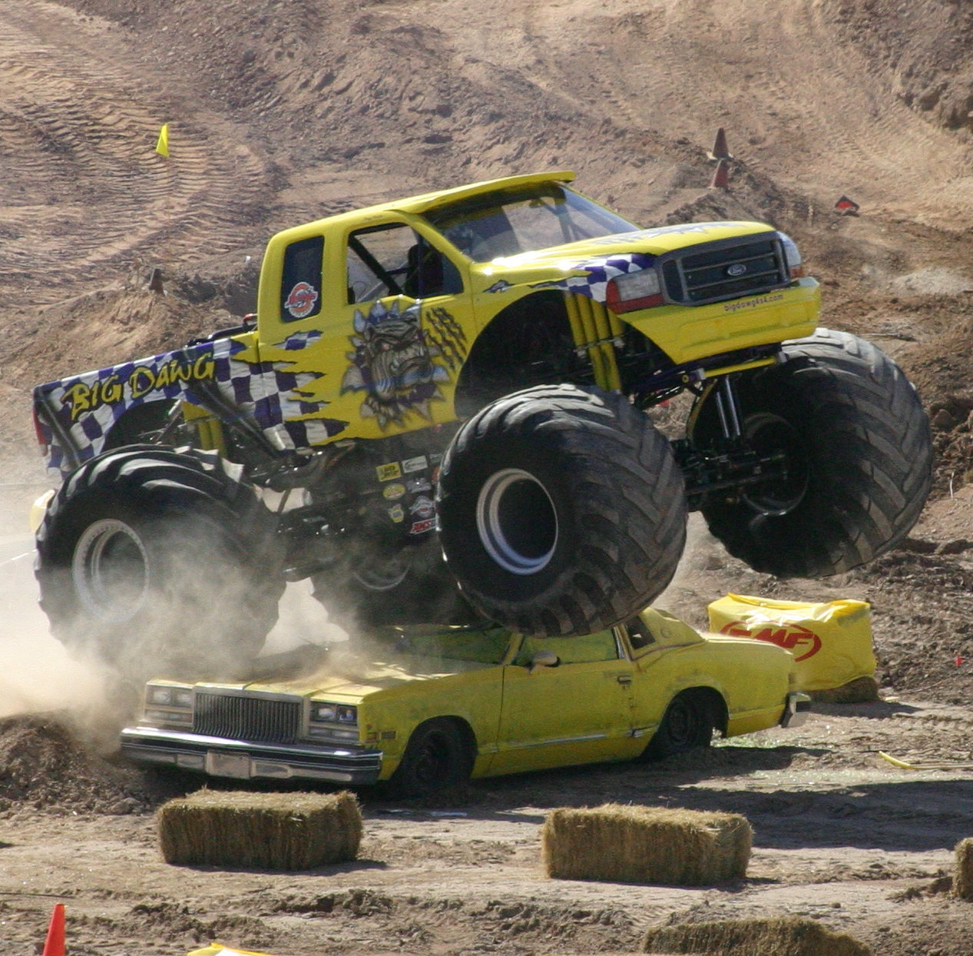
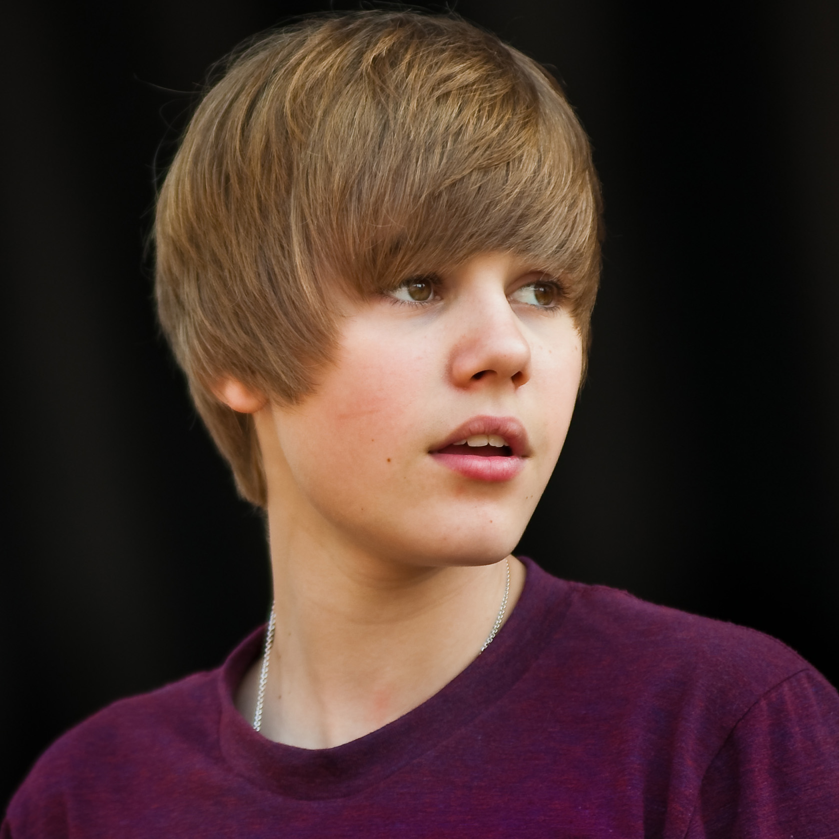
What DO black hat Hackers Want?
Desired outcomes
Money
Inflict Damage
Fame / Reputation / Attention

Slide 12
How might they get those things?
A Means to an end
Steal compute to mine coins
Steal compute to perform illegal activities for money e.g. DDOS or SPAM for money
Steal and sell confidential data e.g. credit card numbers or company secrets
Remove / encrypt master copies of data e.g. source code, and demand a ransom for returning it.
Create unauthorised access point and sell it
Money
Disrupt live services e.g. take websites offline or change live content
Expose data containing company secrets e.g. financial information
Expose a company’s customer account data e.g. passwords
Expose data that a company is obligated to protect e.g. their customer’s personal details
Inflict Damage
Demonstrate having achieved any of the above outcomes (using their untraceable online identity)
Provide tools or instructions or credentials that will demonstrate how to perform a hack
Unauthorised publishing of defamatory / reputation damaging information.
(Most of these could also be done by a grey hat.)
Fame / Reputation / Attention

Slide 13

Then WHAT ARE WE PROTECTING?

Slide 14
What are we protecting?
Everything highlighted and underlined
Steal compute to mine coins
Steal compute to perform illegal activities for money e.g. DDOS or SPAM for money
Steal and sell confidential data e.g. credit card numbers or company secrets
Remove / encrypt master copies of data e.g. source code, and demand a ransom for returning it.
Create unauthorised access point and sell it
Use of compute
Data (CIA)
Money
Disrupt live services e.g. take websites offline or change live content
Expose confidential data containing company secrets e.g. financial information
Expose a company’s customer account confidential data e.g. passwords
Expose confidential data that a company is obligated to protect e.g. their customer’s personal details
Inflict Damage
Demonstrate having achieved any of the above outcomes (using their untraceable online identity)
Provide tools or instructions or credentials that will demonstrate how to perform a hack
Unauthorised publishing of defamatory / reputation damaging information.
(Most of these could also be done by a grey hat.)
Fame / Reputation / Attention

Slide 15

WHAT WE are DEFENDING about it
Remember - C.I.A.
Confidentiality
Integrity
Availability

Slide 16
What DO Hackers need?
End and Interim Targets
INTERIM
Accesss to Create and Use
Cloud
Resources
Access to
Data
Credentials

Slide 17

DEFENSE IN DEPTH

Slide 18
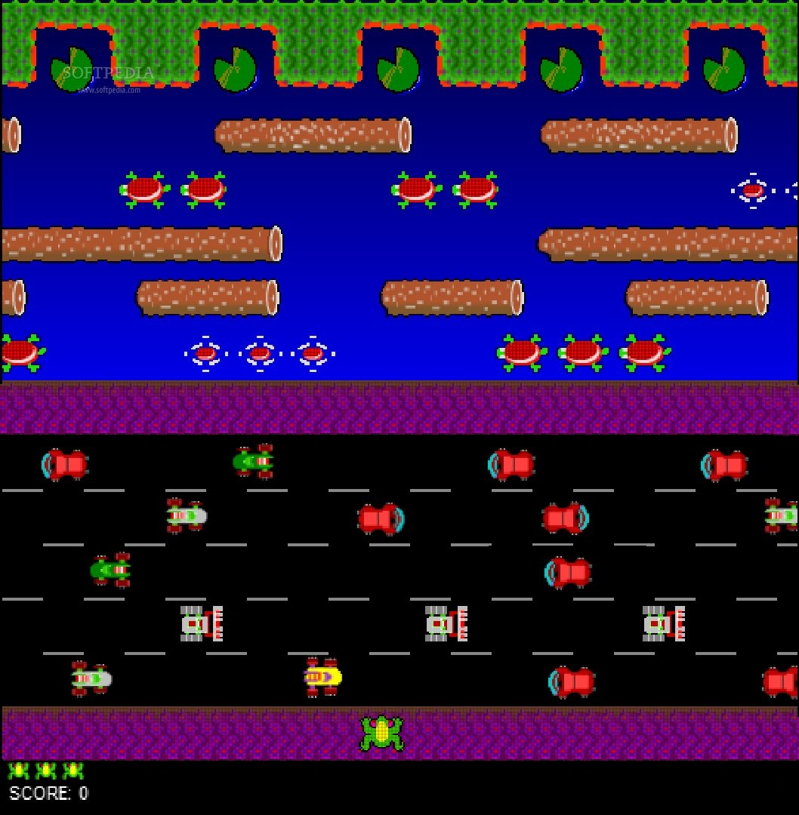
TARGETS
CONTROLS
INIFINITE
RETRIES!
HACKER

Slide 19
What is Defense in Depth
THE NUMBER OF OBSTACLES WE PUT IN PLACE
Accesss to Create and Use
Cloud
Resources
Access to
Data
Credentials
LOTS OF LAYERS OF CONTROLS!

Slide 20
An ASIDE: What is THREAT MODELING?
Sometimes also called
“attack driven defense”
Accesss to Create and Use
Cloud
Resources
Access to
Data
Credentials
CONSIDERING WHAT HACKERS MIGHT WANT TO DO AND HOW

Slide 21
Controlling access to cloud resources
Different paths a hacker might
take to access use cloud resources
I can do what I want
Use Cloud Resources
I can elevate my access to do what I want
Separation of duty
I am able to access the network containing the target
Resource e.g. OS patching
I can compromise an application to take control of a resource
I can connect directly to the OS
I can take control of a resource via an OS vulnerability
Credentials
Credentials
Resource e.g. OS security
Resource e.g. OS authentication
Not on the internet

Slide 22
Controlling creation of cloud resources
Different paths a hacker might
take to create more cloud resources
I can do what I want
Create Cloud Resources
I can elevate my access to do what I want
Separation of duty
Credentials found
I am able to access the network containing the cloud console / management API
Don’t use credentials / leaving lying around.
Use reputable cloud provider
(See credentials slide)
Have credentials
Through compromising a resource (see last slide) I gained credentials
The cloud provisioning console has a vulnerability
Credentials
(See previous slide)
Not on the internet

Slide 23
Controlling access to data
Data is stored on this server
Different paths a hacker might
take to access data
I am able to access the network containing the target
Store the minimum
Data
I can access the data with the user I am using
I can elevate my access to see the data
Application security
Separation of duty
Credentials
I can compromise an application to access data
I can see data
Resource e.g. OS patching
I can compromise an application to take control of a resource
I can connect directly to the OS
I can take control of a resource via an OS vulnerability
Application authentication and authorisation
Application security
Resource e.g. OS authentication
Not on the internet

Slide 24
Controlling credentials
Different paths a hacker might
Gain credentials
Credentials
Educate team
I am able to access the network containing the target
Educate team
Educate team
Someone published their credentials
Someone revealed to me their credentials (snooping)
Someone revealed to me their credentials (social)
Not on the internet

Slide 25
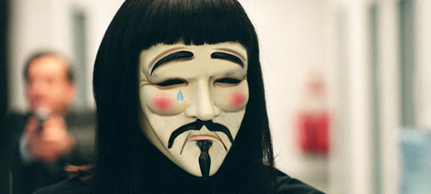
Reducing likelihood Reducing impact
< All of our controls do this

Slide 26

STEPPING STONES FOR SUCCESS
WHAT ARE WE PROTECTING?
Stepping Stones to Success
Next session:
Where our Standards come in
HOW DO OUR STANDARDS HELP?

